Slide 1
WARNING
These slides are not optimized for printing or exam preparation. These are for lecture delivery only.
These slides contain a lot of animations. For optimal results, watch in slideshow mode.

Slide 2
CS2103/T Week 6
[Sep, 2024]
[60 minutes]
Which one doesn't have an abstraction problem? Tip: check if the comment, name, parameters, return value all fit together well.
Subjective. Context-dependent. Focus on the reasoning rather than the answer.
/**
* UI uses this for formatting text.
*/
String format(String s) {
(a)
(b)
void execute(String delimiter) {
/**
* @return list of persons.
*/
List<String[]> execute(Command command) {
(c)
/**
* Executes the given command.
* @return the Result of the execution.
*/
Result execute(Command command) {
(d)

Slide 3
Answer this in the LumiNUS quiz
1
/**
* UI uses this for formatting text.
*/
String format(String s) {
Good?
Yes
No
The comment refers to the user of the method

Slide 4
2
void execute(String delimiter) {
Good?
Yes
No
Parameter doesn’t fit.

Slide 5
3
/**
* @return list of persons.
*/
List<String[]> execute(Command command) {
Good?
Yes
No
Return value doesn’t fit.

Slide 6

4
/**
* Executes the given command.
* @return the Result of the execution.
*/
Result execute(Command command) {
Good?
Yes
No
Everything fits; the method makes sense on its own.
Notes:
Poll Title: What word is common to all three? https://www.polleverywhere.com/free_text_polls/FVHmj72Se36E1qleFLSyi

Slide 7
Picking the right abstractions (for the problem at hand) is key. If you can do that, you are half way there!
All four might work as expected. And yet, some are better abstractions than others …
e.g., easily understood without needing additional info
might not matter if, might make a big difference if, 500LoC 50,000 LoC
to the author other developers
1 week later 1 year later

Slide 8


Oh No!!! Where’s my laptop?
X

Slide 9
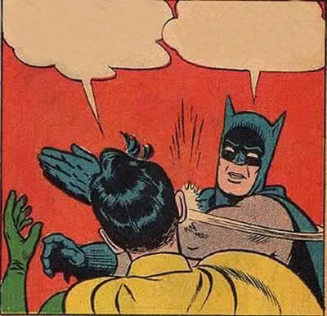

Mom: What did you do today?
You: I went to school,
then went to the canteen,
then I did an unzipOutClose and …

Slide 10

Coding is about communicating
[ ] with humans
[ ] with machines

Slide 11
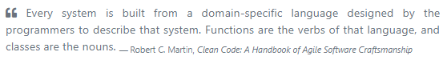
Mom: What did you do today?
You: unzipOutClose
unzipOutClose
unzipBagAndTakeOutThingAndCloseBag()
unzipBag()
takeOutThing()
closeBag()
When defining methods (classes, variables), you are defining a new vocabulary, for readers
Using Java: hard?
Defining a new language well: harder!

Slide 12
Mom: What did you do today?
You: walked to the bus stop, got on the bus, tapped the bus card, walked to a seat, sat down, …

Slide 13
Mom: What did you do today?
You: went to school, …
You: went to school, went to canteen, checked email, had breakfast, …
Mom: Checked email? How exactly?
You: went to school, …
You: took the laptop out,
logged in, …

Slide 14


Single Level of Abstraction Principle
SLAP ?
SLAP ?
Haphazard breaking into smaller methods is not SLAP!
Instead, extract the right vocabulary to explain the high-level logic

Slide 15
How’s SLAP here? How many levels? 0 1 2 3 4 5+
private static ArgumentMultimap extractArguments(String argsString, List<PrefixPosition> prefixPositions) { // Sort by start position prefixPositions.sort((prefix1, prefix2) -> prefix1.getStartPosition() - prefix2.getStartPosition()); // Insert a PrefixPosition to represent the preamble PrefixPosition preambleMarker = new PrefixPosition(new Prefix(""), 0); prefixPositions.add(0, preambleMarker); // Add a dummy PrefixPosition to represent the end of the string PrefixPosition endPositionMarker = new PrefixPosition(new Prefix(""), argsString.length()); prefixPositions.add(endPositionMarker); // Map prefixes to their argument values (if any) ArgumentMultimap argMultimap = new ArgumentMultimap(); for (int i = 0; i < prefixPositions.size() - 1; i++) {
// Extract and store prefixes and their arguments Prefix argPrefix = prefixPositions.get(i).getPrefix(); String argValue = extractArgumentValue(argsString, prefixPositions.get(i), prefixPositions.get(i + 1)); argMultimap.put(argPrefix, argValue); } return argMultimap; }
So, is SLAP good enough in this case?

Slide 16
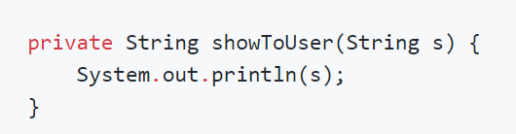
Does the println bother you?
What’s going on here…? I can’t understand this code because I don’t see the code of this method ☹
What if the code of the method was given here instead? Easier to understand?
I don’t want to split code into many methods because it makes the code hard to understand!

Slide 17

Intention
Mechanism
Is this worth abstracting?
( ) yes
( ) no
( ) perhaps
Notes:
Poll Title: What word is common to all three? https://www.polleverywhere.com/free_text_polls/FVHmj72Se36E1qleFLSyi

Slide 18
Where to find examples of good quality code?
Not much easily accessible good quality code.
OSS code: Readability may not be a priority.
Too big for beginners?

Slide 19
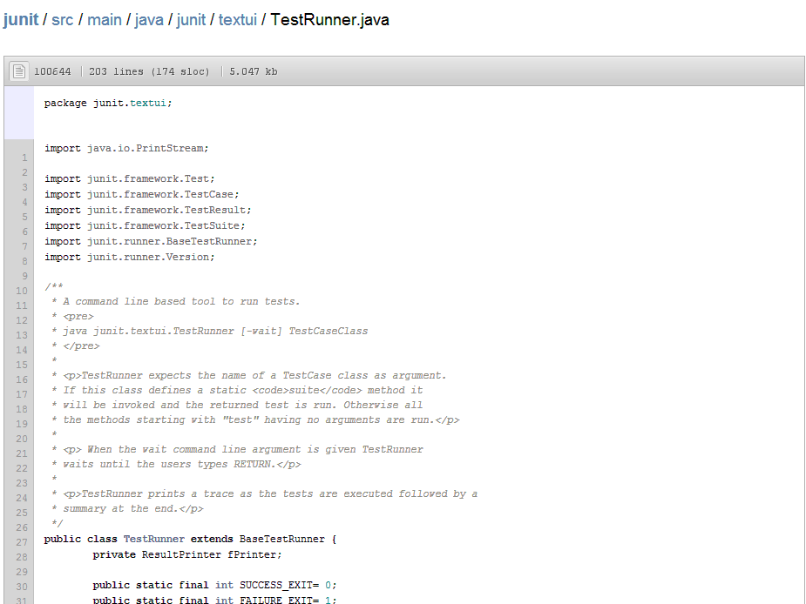

[extra] Junit code sample
Javadoc comments

Slide 20
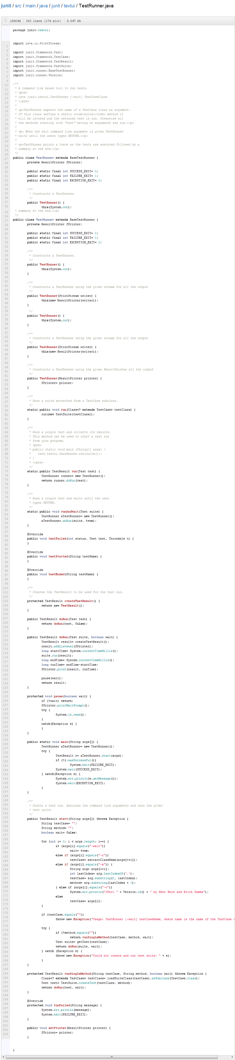
Indentation?

Slide 21
Very small methods

Slide 22
[extra] Junit code sample

Slide 23
Guard clause!

Slide 25
Good code looks neat.

Slide 26
Good Code

Slide 27

Good Code

Slide 28
Is this the best it can be?
Good Code
When to stop?
… under the circumstances
Incremental cost, benefit:
Intended use for the code?
Who will change the code? How often?
Cost of regressions?
…

Slide 29


Good Code
Code gorilla
Code monkey

Slide 30
Master craftsman
Good Code
Code gorilla
Code monkey

Slide 31

The aim of this module is,
Master craftsman
a
Good Code
Code gorilla
c
b
Code monkey

Slide 32




What’s the best paradigm?
Procedural
OOP
Functional
A mix
It depends:
e.g., on the application domain, tech stack , the nature of data sources, expertise of future devs, …
Good OOP != OOP Good learn OOP well, push it to its limits, learn pros/cons

Slide 33
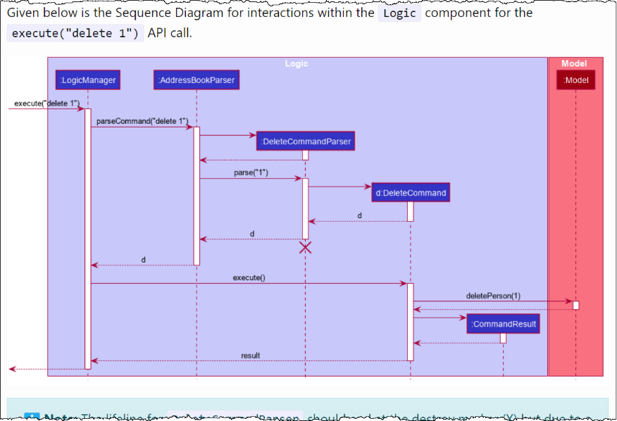
Interpreting only!

Slide 35




It’s your primary weapon. Soon: Learn basics first

Slide 36

It’s your primary weapon. Soon: Learn basics first
Long term: Become an IDE ninja

Slide 37
You must use Intellij IDEA in this module
( ) True
( ) False
Can use alternatives; productivity is the actual goal
But must be aware of and know how to use IDEs

Slide 38

It’s your primary weapon. Soon: Learn basics first
Semester-end: Become an IDE ninja

Slide 39
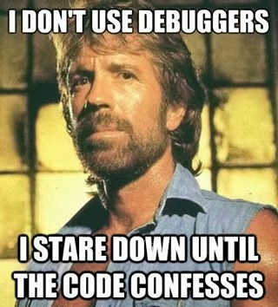
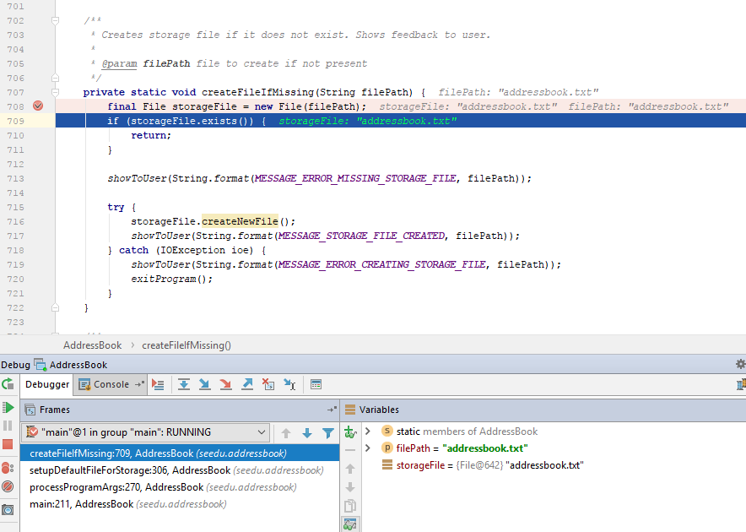
‘eyeballing’ code to find the bug
Also useful for learning the code

Slide 40
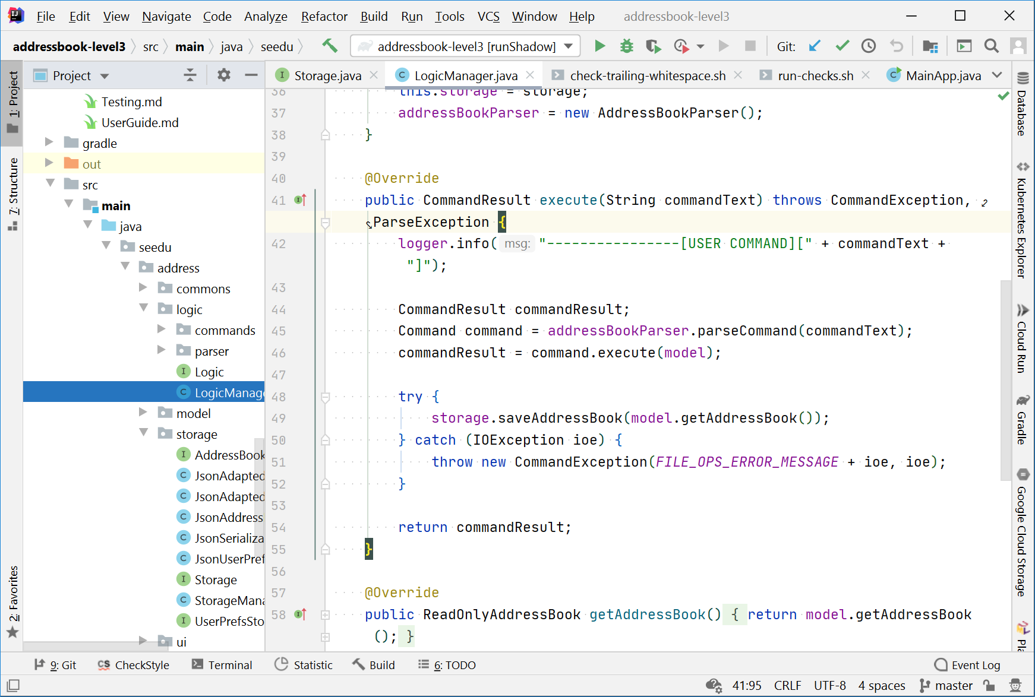
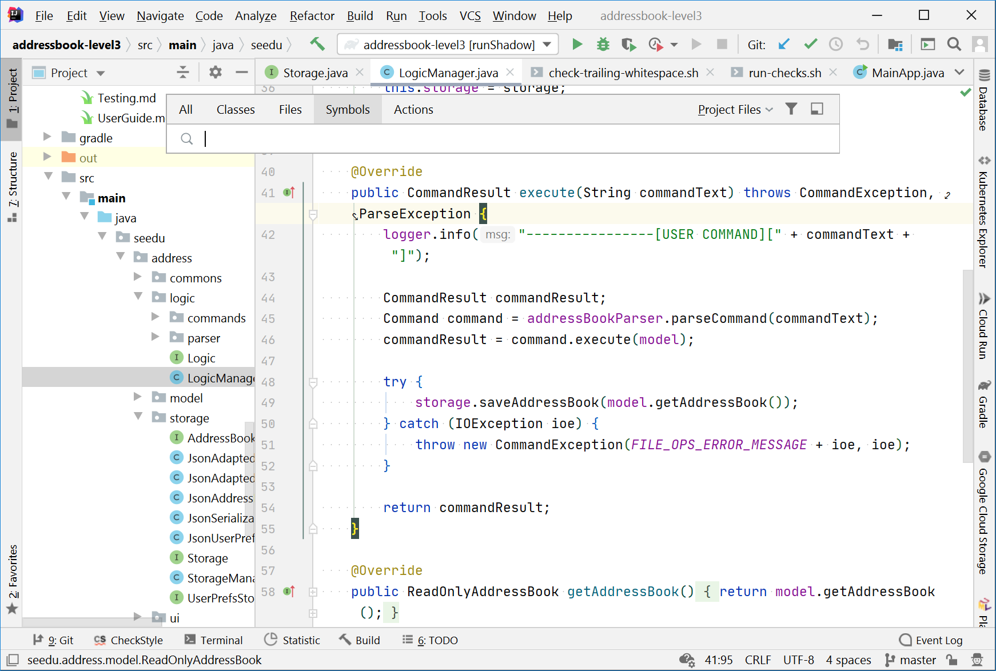
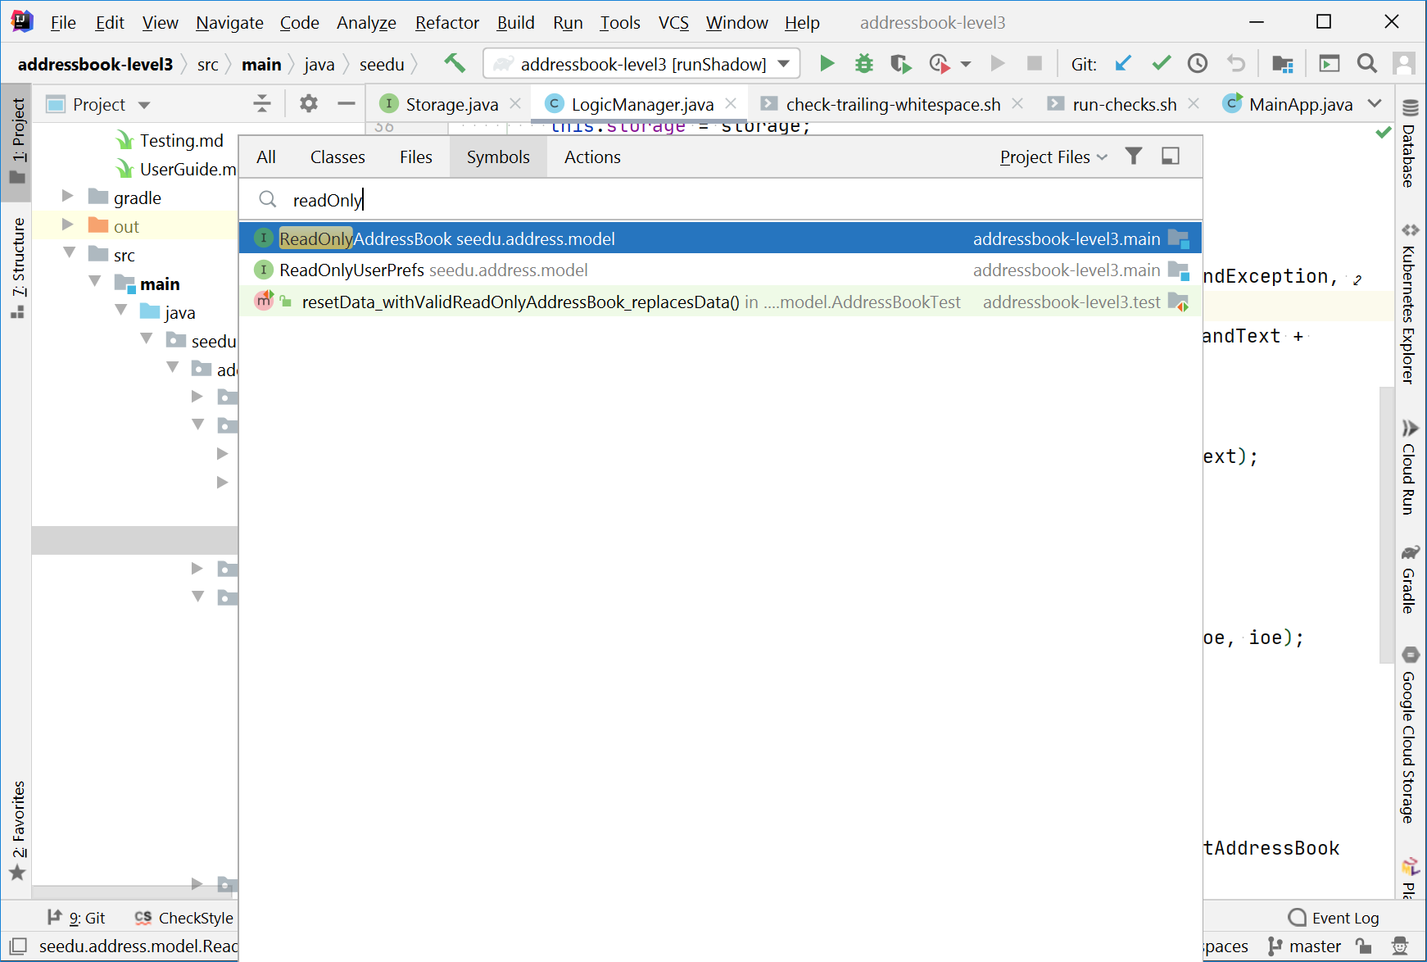
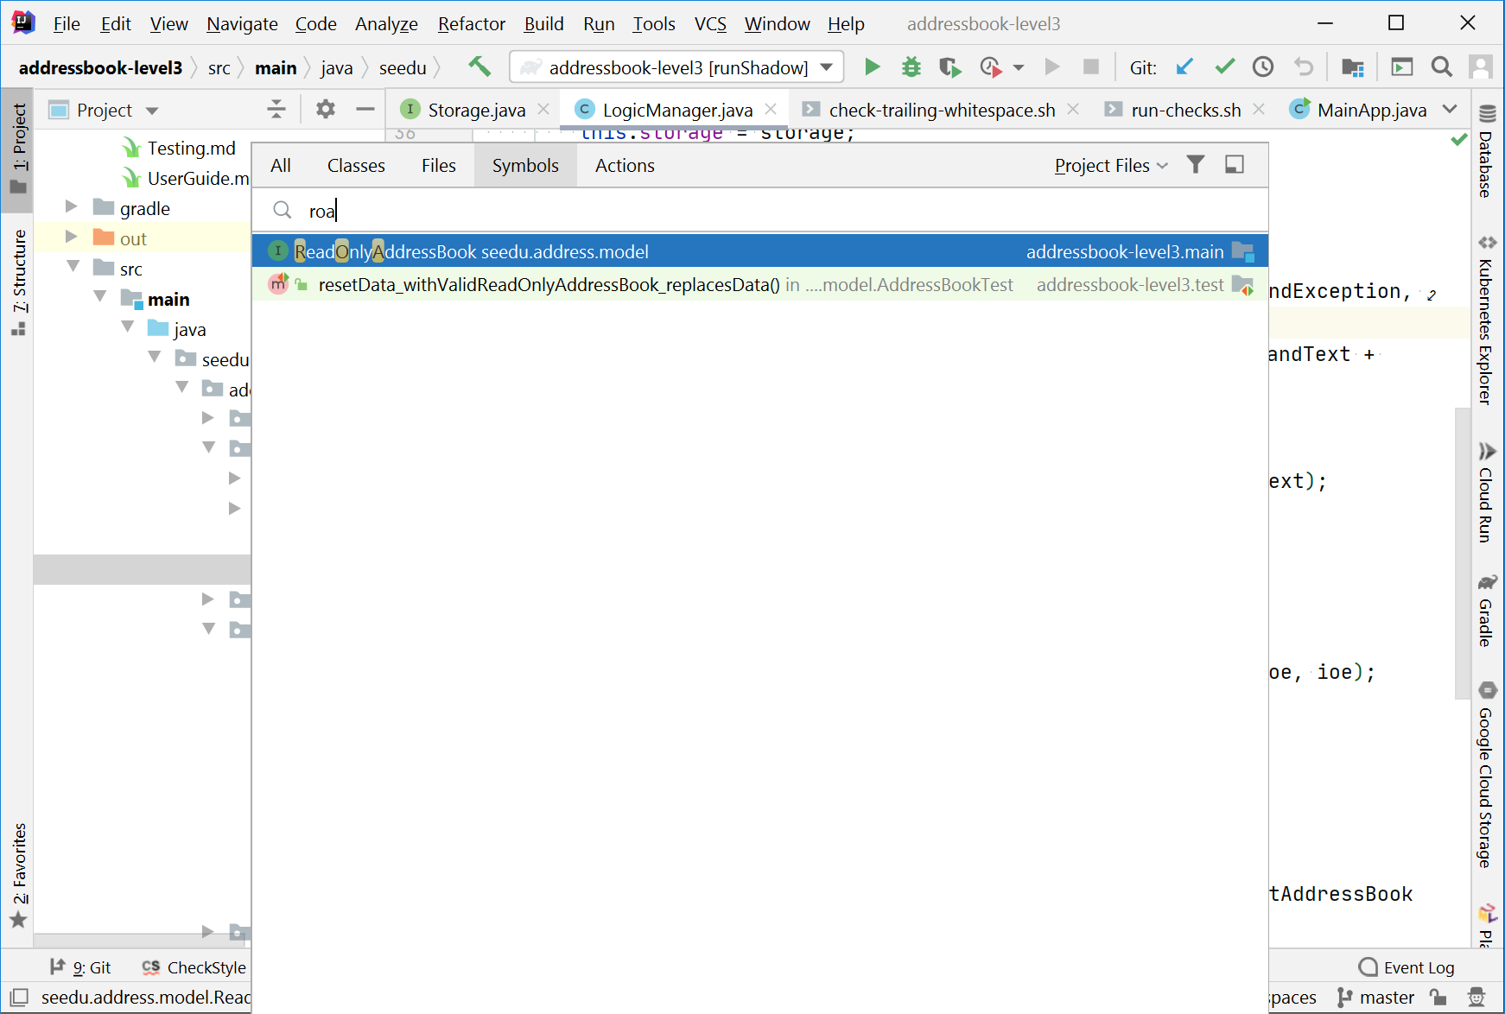
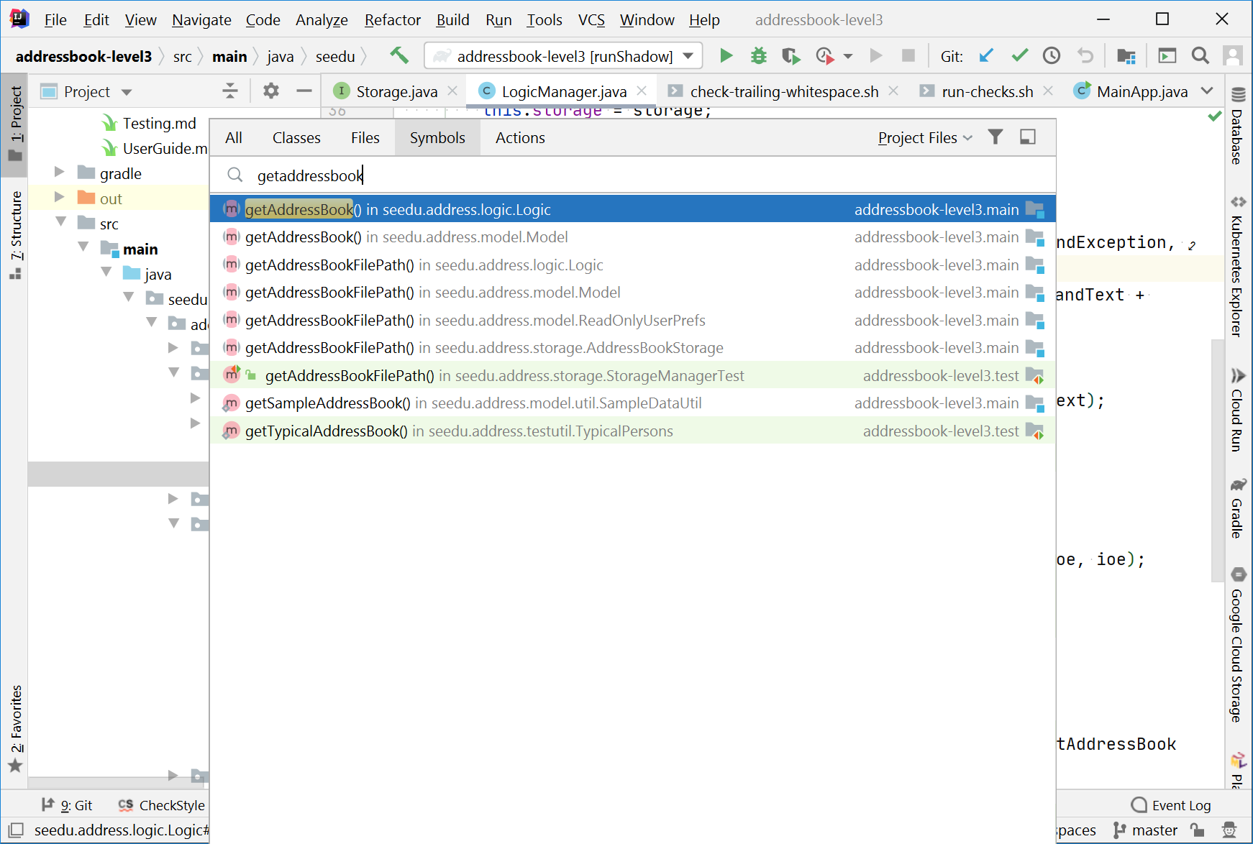
Search for symbol (Windows): Ctrl + Alt + Shift + N

Slide 41
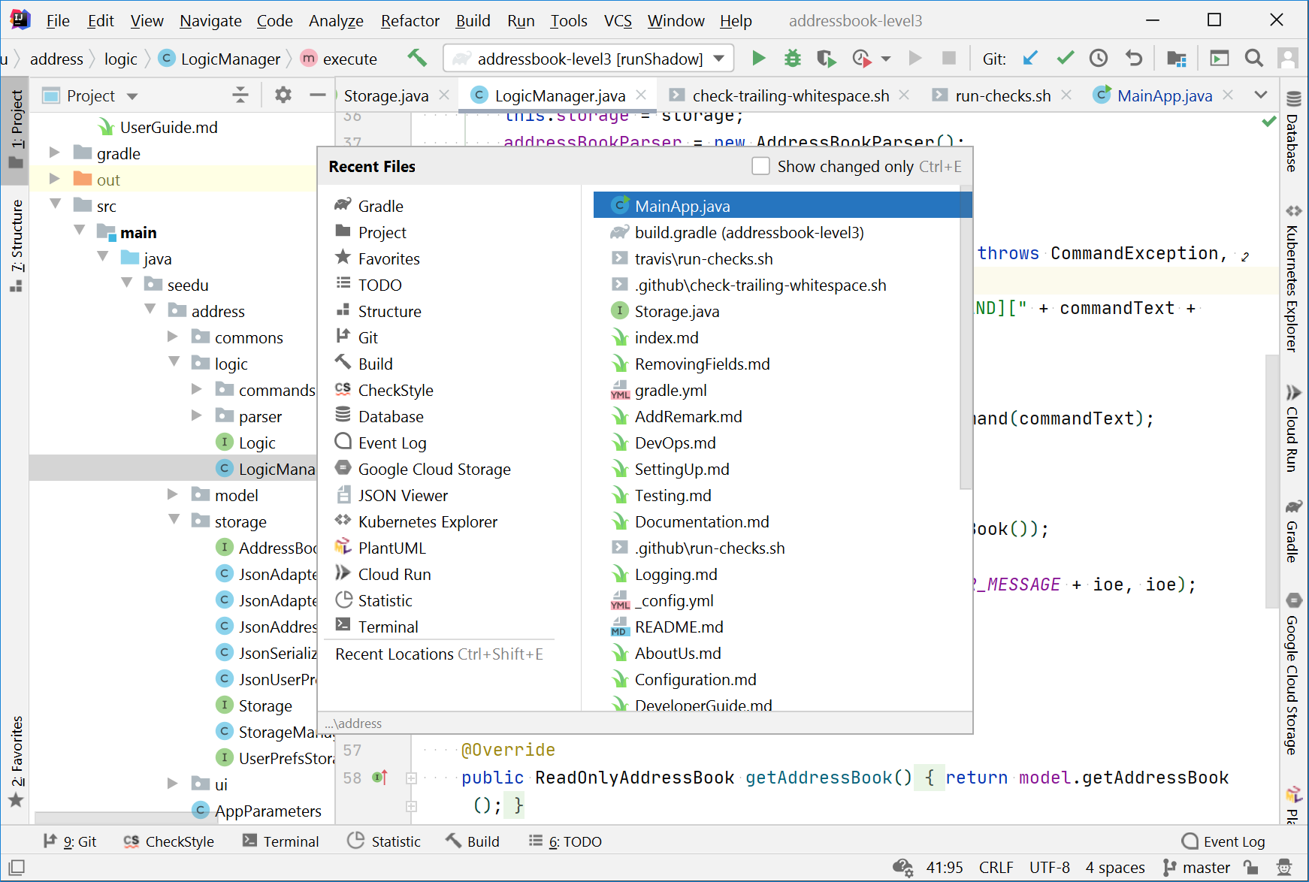
Show recent files (Windows): Ctrl + E

Slide 42
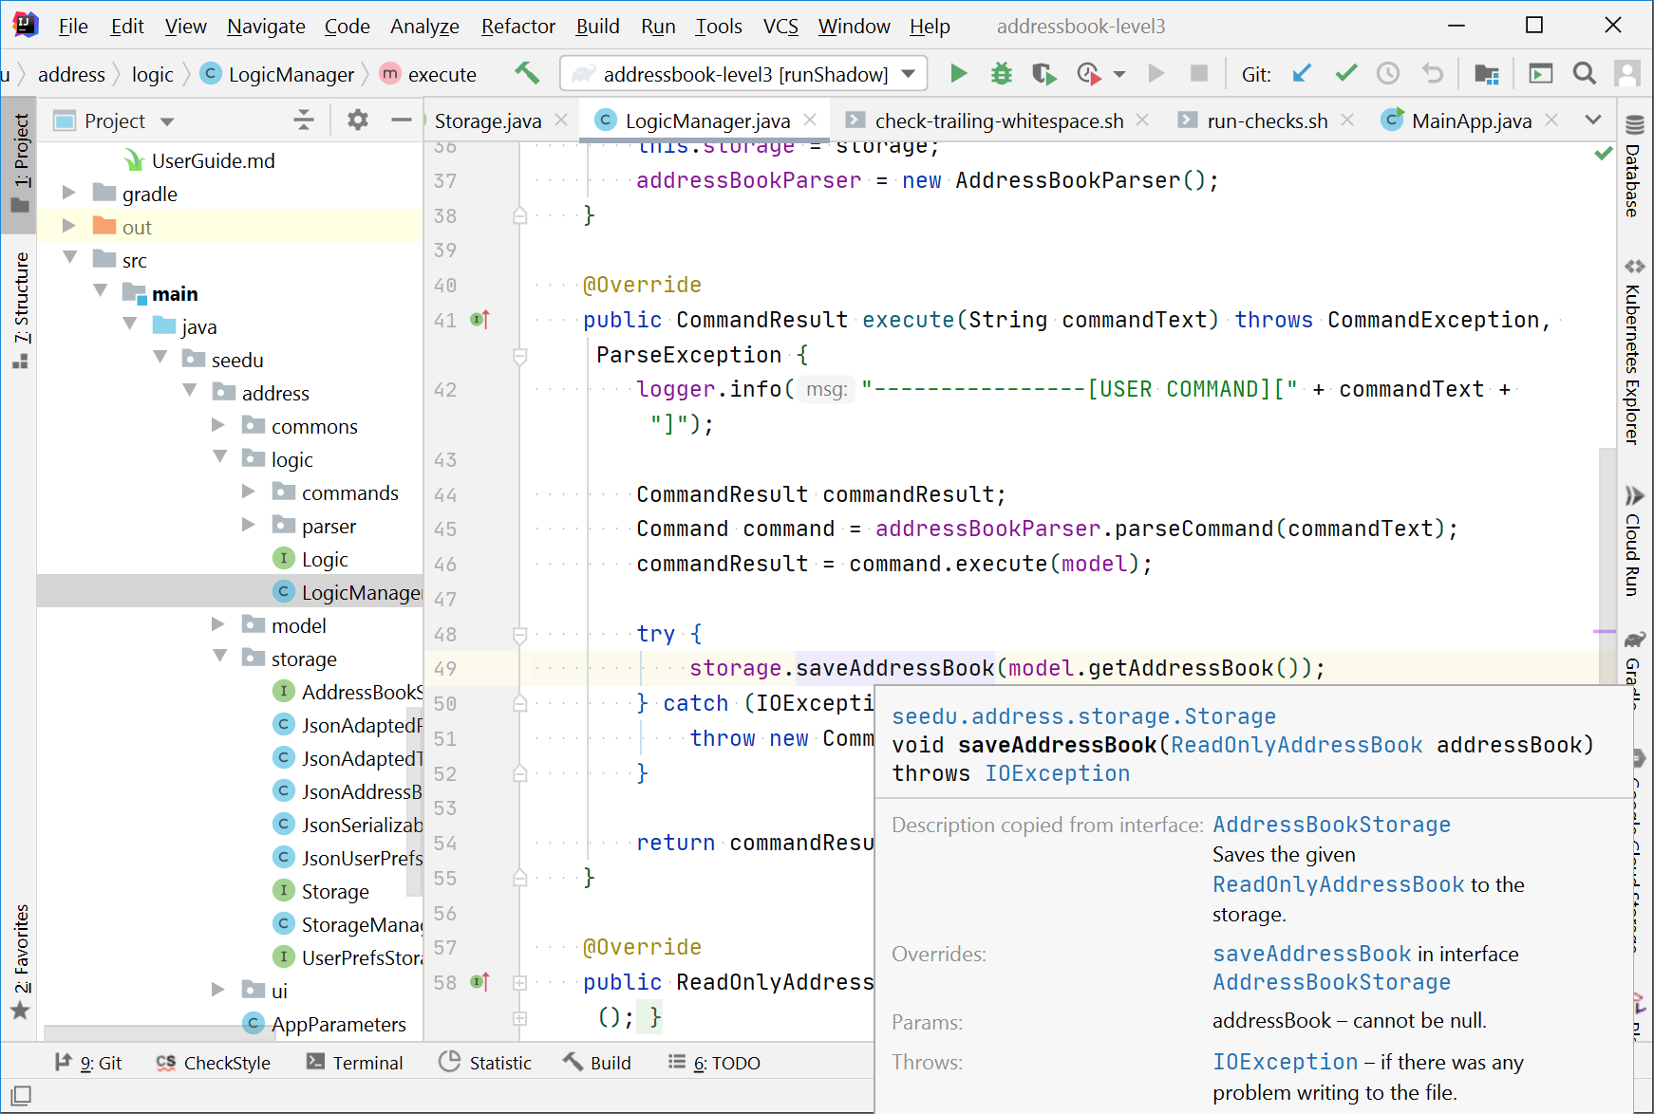
Quick documentation (Windows): Ctrl + Q

Slide 43
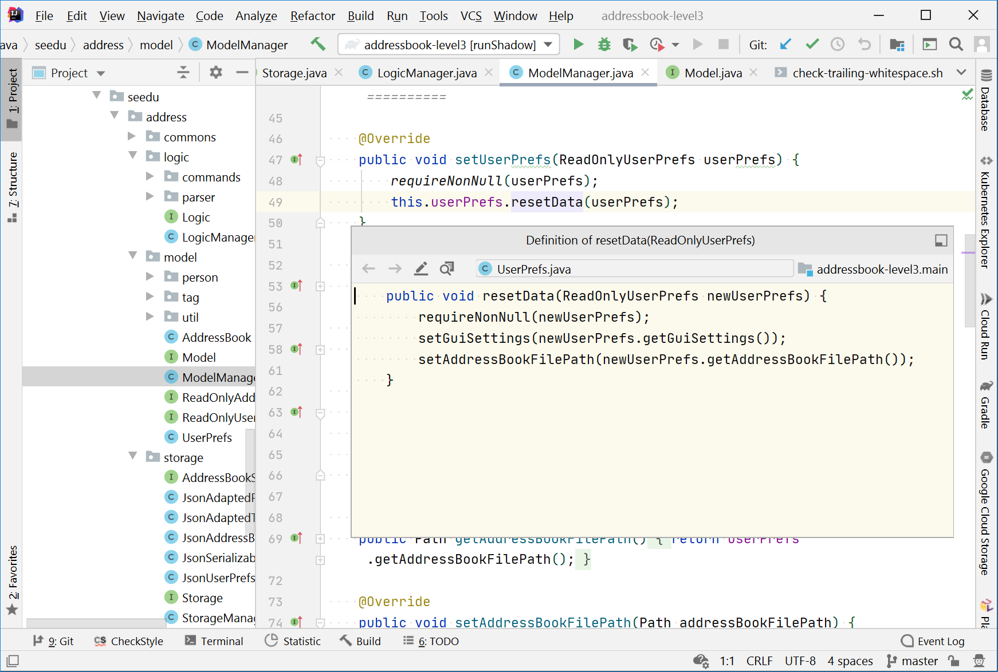
Show definition (Windows): Ctrl + Shift + I

Slide 44
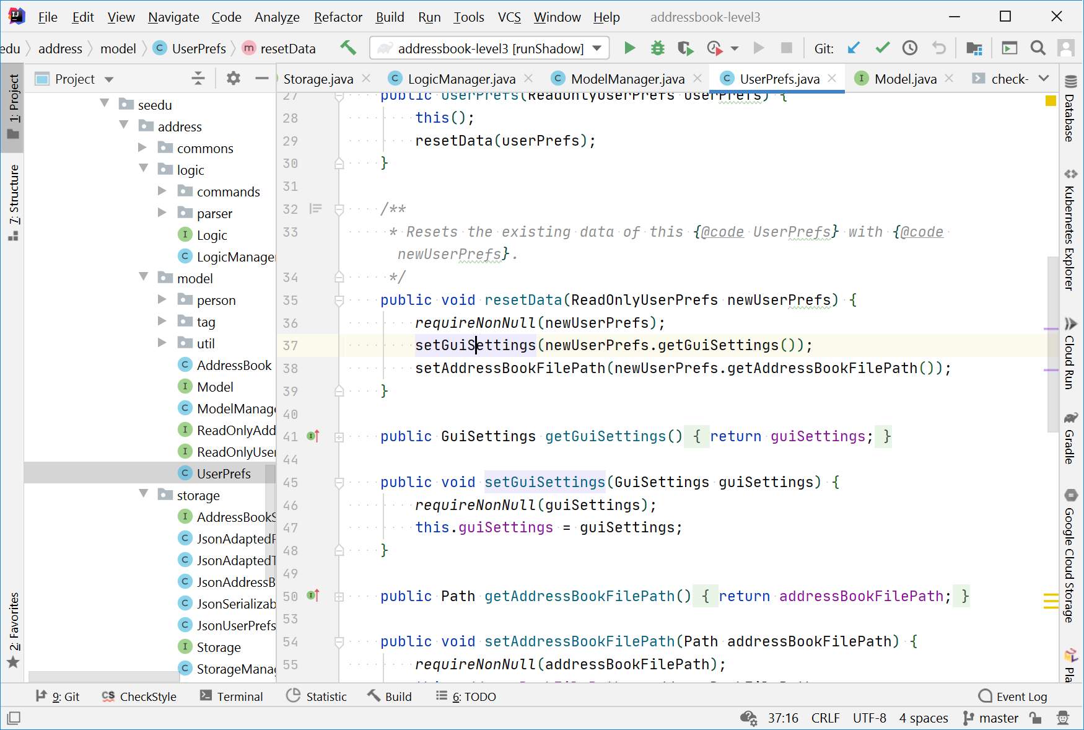
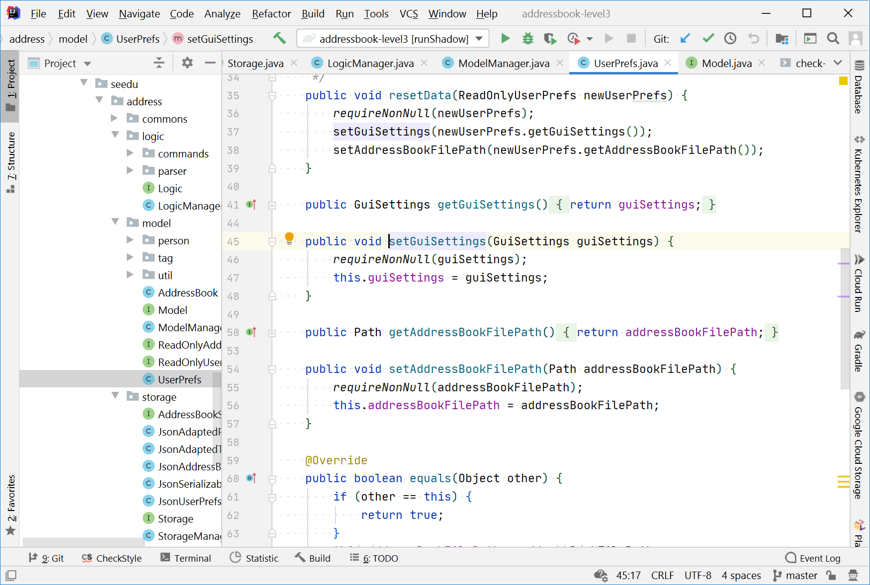
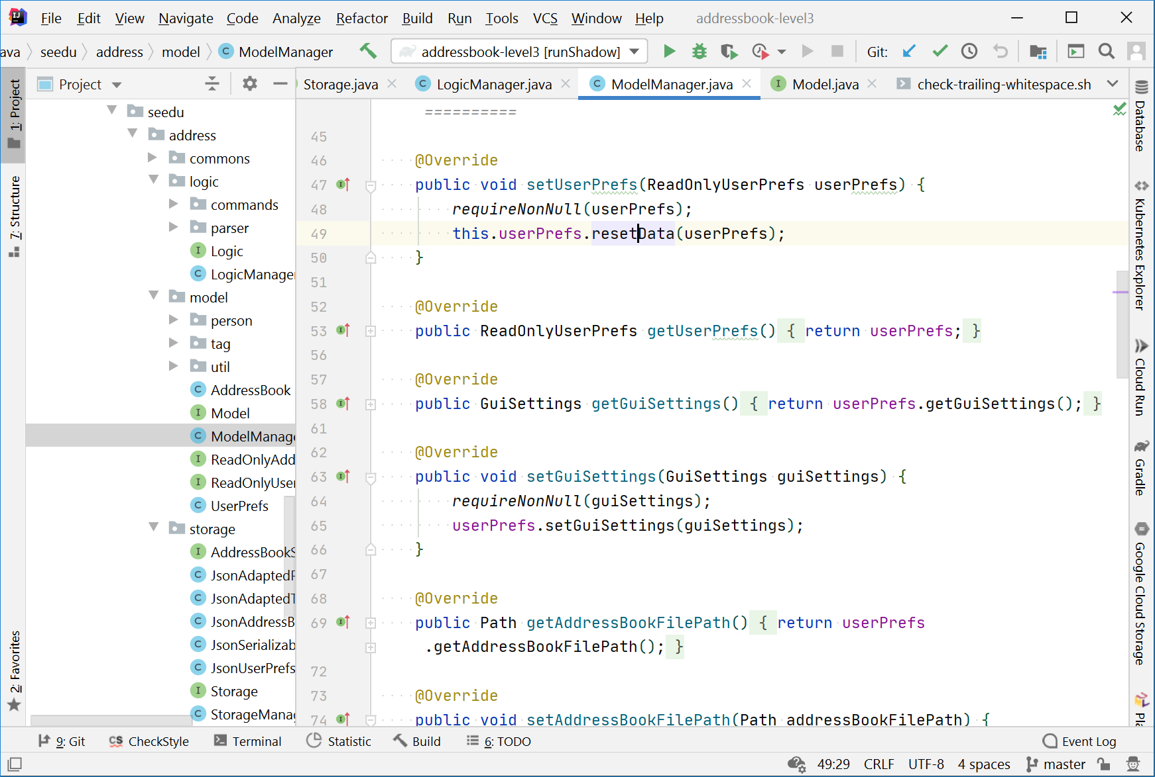
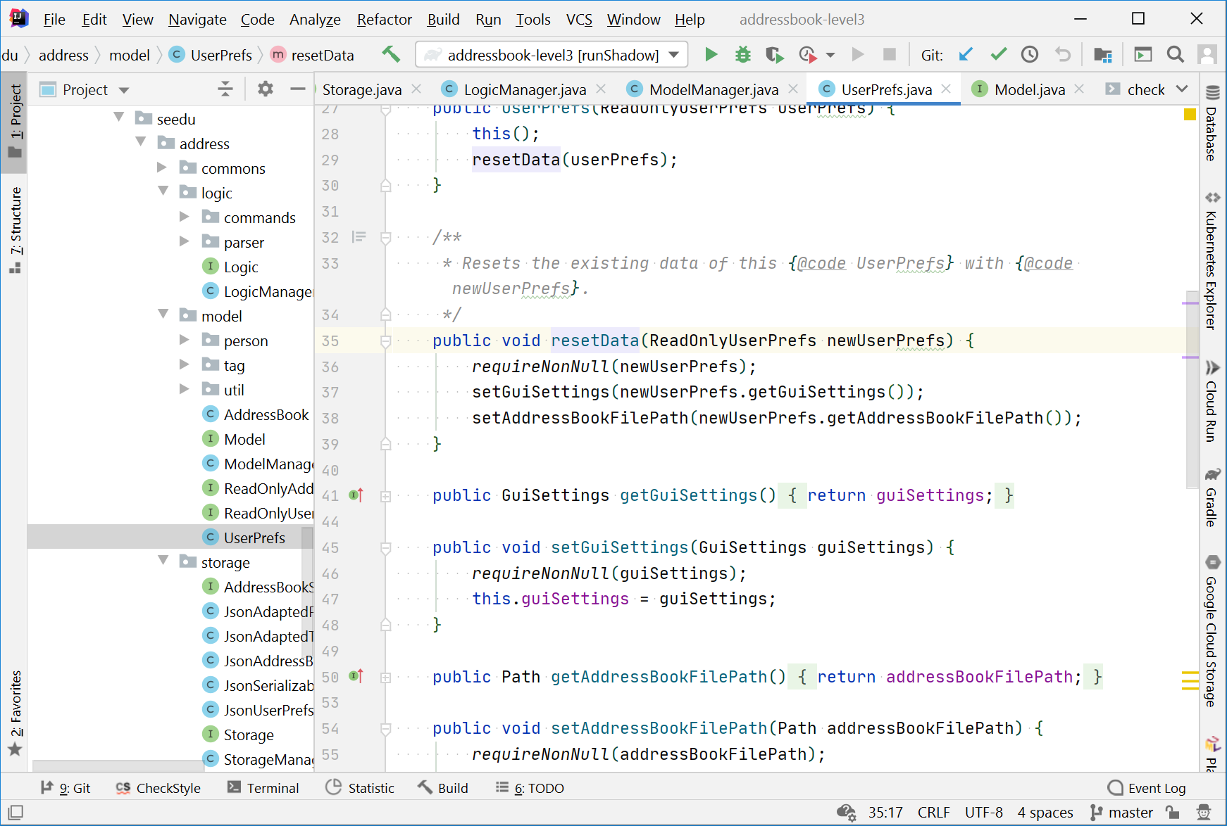
Go to definition (Windows): Ctrl + B

Slide 45
Go back (Windows): Ctrl + Alt + ← / →

Slide 46
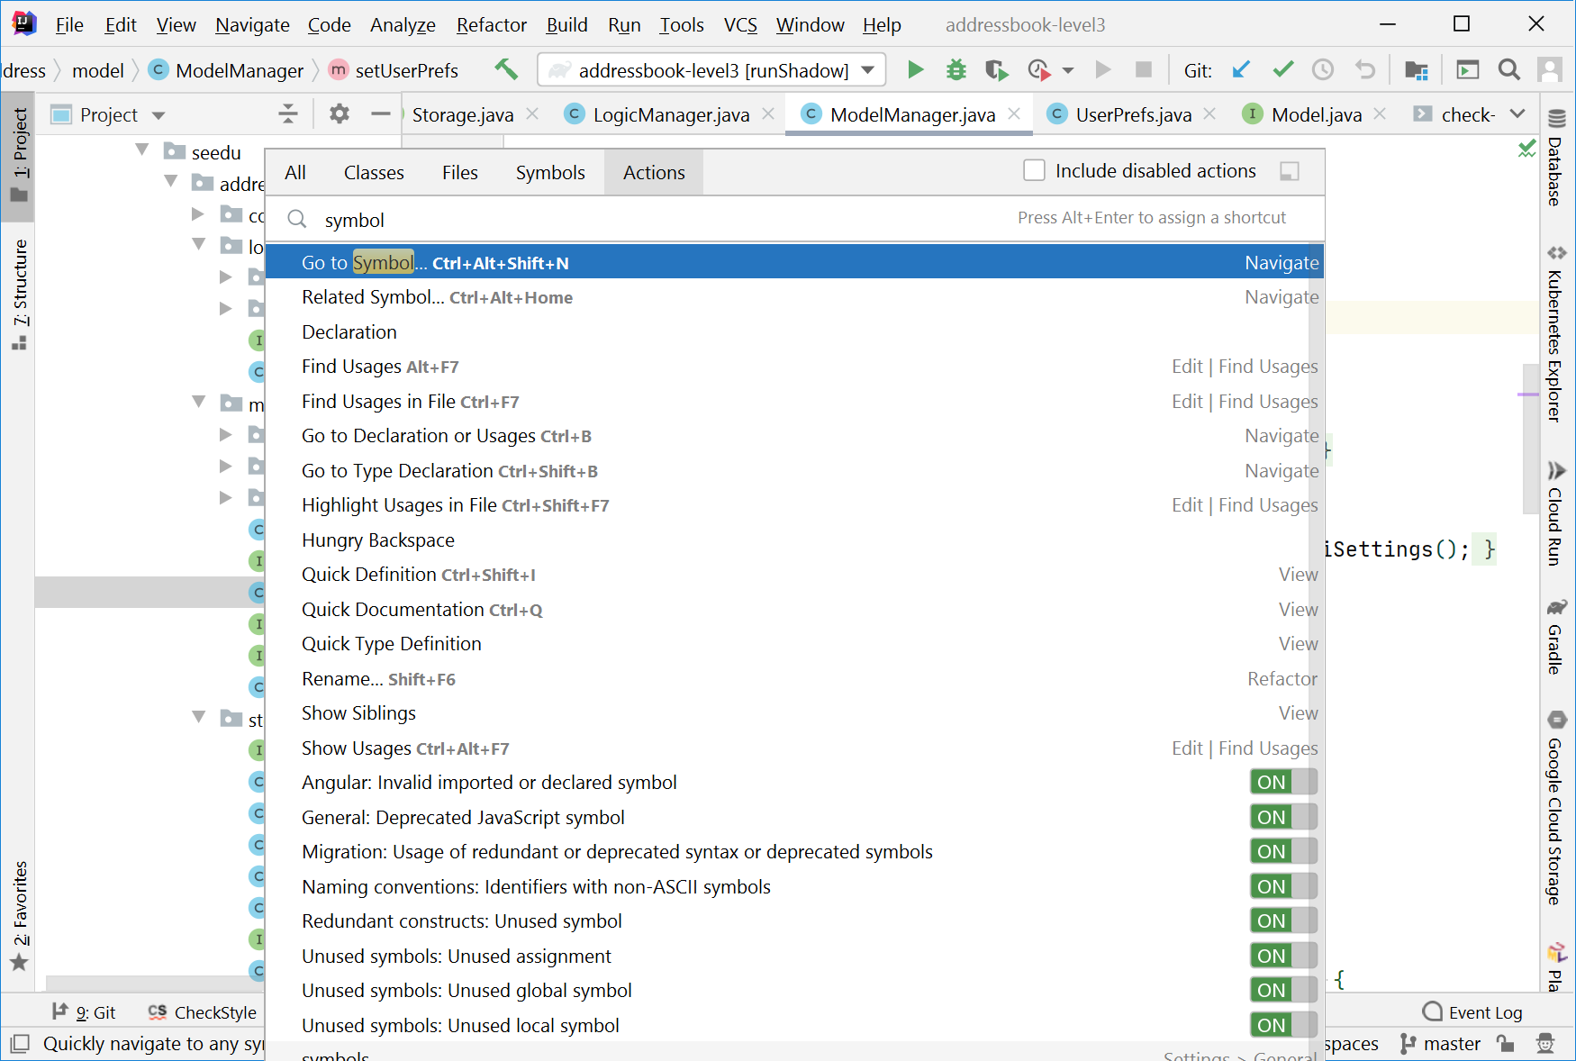
Search actions (Windows): Ctrl + Shift + A

Slide 47
Some code navigation features
Find Class : Ctrl + N (supports CamelCase too)
Find File: Ctrl + Shift + N (type \ to find folders)
Find Symbol : Ctrl + Alt + Shift + N
Quick Documentation: Ctrl+Q
Quick Implementation: Ctrl + Shift + I
Navigate to Declaration: Ctrl + B
Go back/forward: Ctrl + Alt + →/←
How to remember shortcuts:
* Search shortcuts: Ctrl + Shift + A
* Say the shortcut (in your mind) every time you use it.

Slide 48
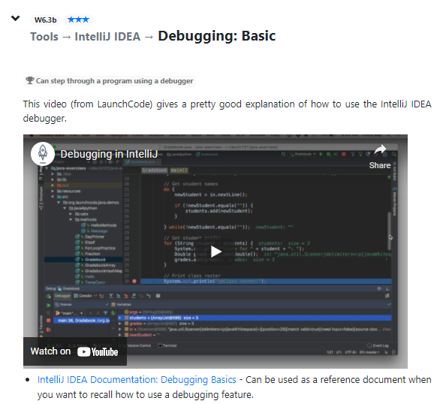
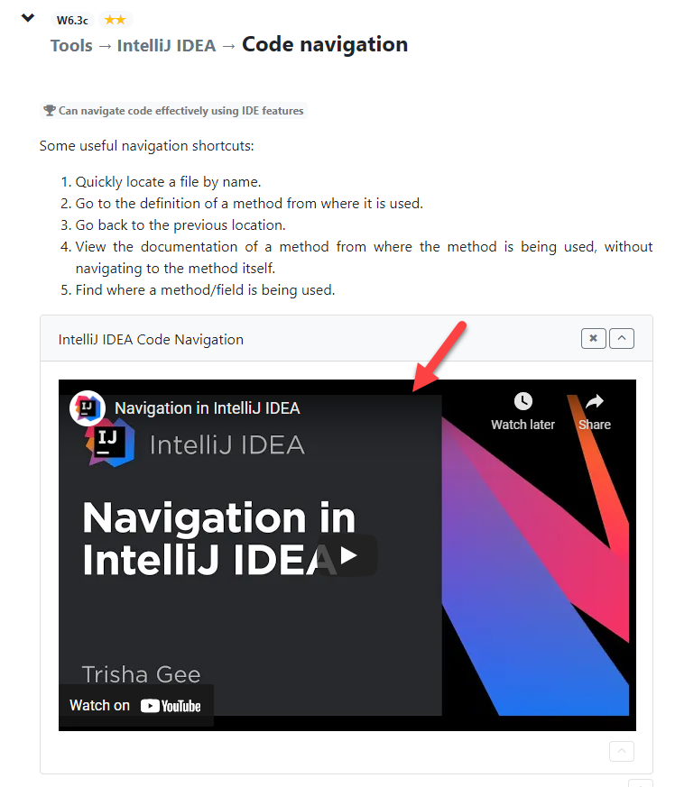

Slide 49
There are some concrete deliverables for this item

Slide 50
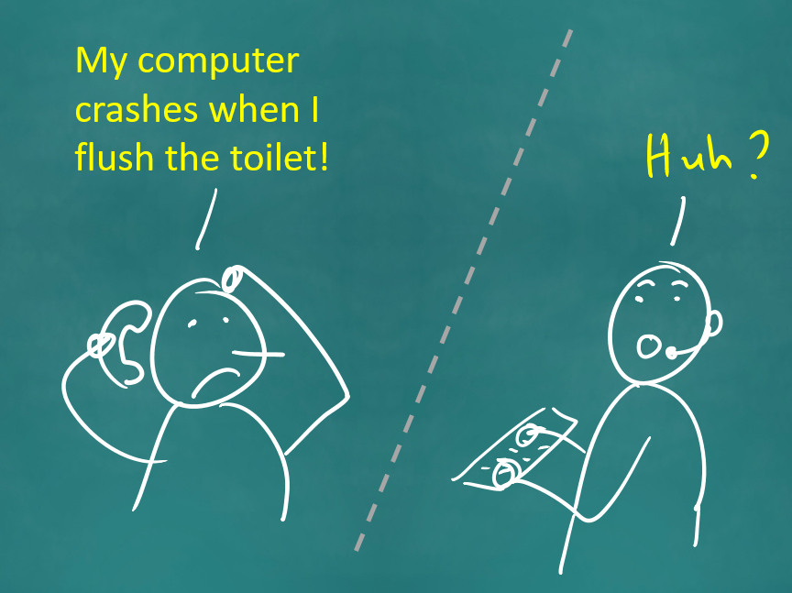

Slide 52
Make it as small as possible, but can add more if time left

Slide 53
